Slide 1
Aung Myin Kyaw (Max) weekly Research Progress Report
Date : 18/08/2018 to 25/08/2018
Scope of the work:
Understanding of Raman spectroscopy. How it works and the applications.
Downloading and setting up of necessary programs.
Understanding how Visual Studio 2017 and C# 7 works.

Slide 2
Research Progress in last week
Understanding the Raman spectroscopy through (https://en.wikipedia.org/wiki/Raman_spectroscopy and other online resources)
Installation of Thorlabs and it’s necessary libraries to write a C# program. In addition, installation of Visual Studio 2017.
Learn basic C# through (https://www.udemy.com/csharp-tutorial-for-beginners/)
Understand different components of Visual Studio 2017 through (https://docs.microsoft.com/en-us/visualstudio/ide/visual-studio-ide?view=vs-2017)
Completed FoE Risk assessment application training quiz at IVLE
Troubleshooting of the CSharpDemo program that was downloaded through Thorlabs library.

Slide 3
Research Plan for next week
Continue troubleshooting the CSharpDemo execution file as it is necessary in the progression of the project.
After successful troubleshoots, study the code and implementation of Thorlabs program using C#.
Understanding the requirement of the program.
Greater in depth research for tools that are available in C# language
.

Slide 4
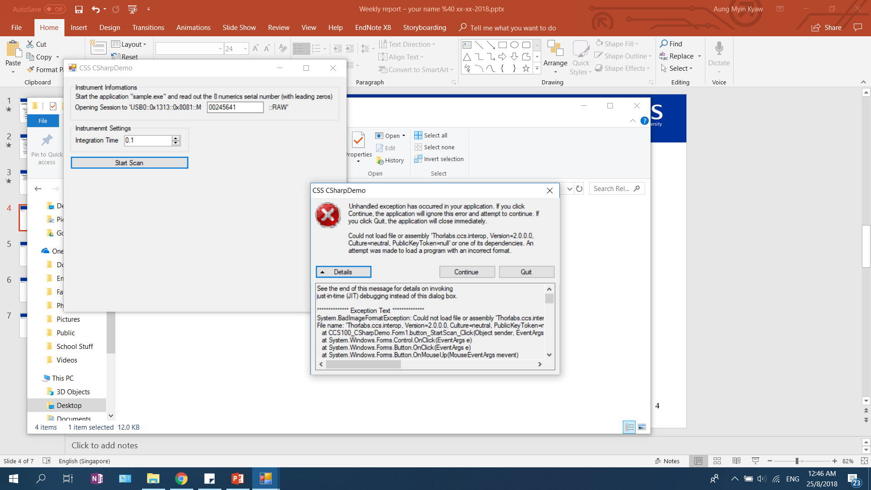
CCS100_CSharpDemo.exe is an execution file provided by Thorlabs for the developer to further customize the Thorlabs to it’s own need. As seen from the above picture, when the CCS100_CSharpDemo.exe is executed there is an exception error. However, since the program that provided has a bug in; I had emailed the Thorlabs technicians to help solve this error.

Slide 5
For FoE Risk assessment application training certificate; I have completed the quiz and lesson in IVLE, however, in order to receive the certificate of qualification there is a hands on lesson to attend. I have emailed the relevant technician for the hands on session. Understanding of C# took sometime as though I am familiar with programming this is a new programming language. Thus, there are certain syntax which are not the same as I have learnt.

Slide 6
